Slide 1
Cancer Metastases
Detection
COMS W4995 Applied Deep Learning
Hanjun Li

Slide 2
Outline
01
02
INTRODUCTION
METHODOLOGY
03
04
RESULTS ANALYSIS
CONCLUSIONS
Background Introduction
and Motivation
Data Preprocessing
and Model Training
Model Testing and
Metrics Evaluation
Limitation and Future
Improvement

Slide 3
01
INTRODUCTION

Slide 4
INTRODUCTION
Motivation: The process of manually performing metastasis detection is labor intensive and error-prone [1]. To relieve the workload of pathologists, scholars proposed utilizing deep learning models i.e. Convolution Neural Network (CNN), to assist pathologists by providing second opinions.
Objective: Leverage deep learning model to detect tumor cells on gigapixel pathology image and experiment with multi-scale zoom levels

Slide 5
BACKGROUND
Based on “Detecting Cancer Metastases on Gigapixel Pathology Images”
(see reference for detail)
KEY TAKEAWAYS:
Utilize Inception (V3) architecture
Input patch size (299, 299, 3) and label of this patch is determined by the central 128*128 region; classify as tumor if at least one pixel in the central region is a tumor pixel
Use two levels of magnification
Data Augmentation helps

Slide 6
WORKFLOW
Data Preparation and Visualization
Train/Test Split, Patch Generation
Model Testing and Generate Heatmap
Model Building

Slide 7
02
METHODOLOGY

Slide 8
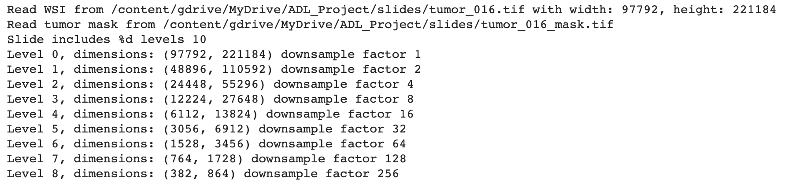
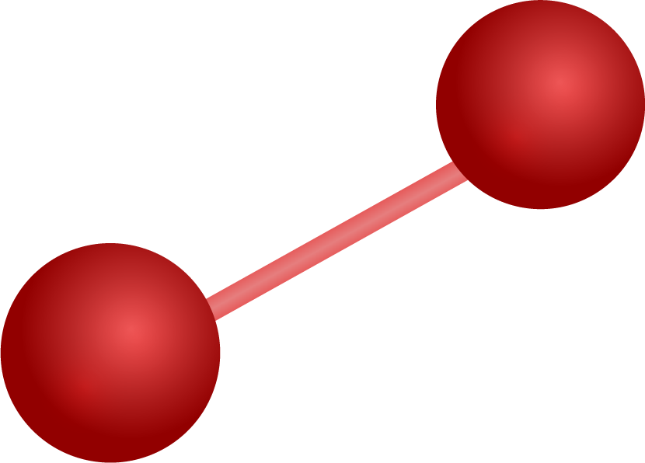
Data Content
Dataset: Camelyon16
Input: lymph node digitized images, tumor mask
Different zoom level associates with different dimension and downsample factor (lower level has higher resolution)

Slide 9
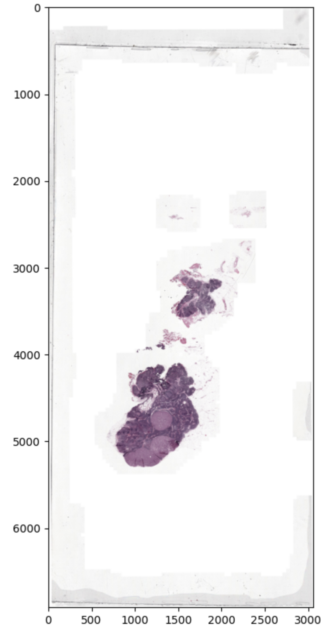
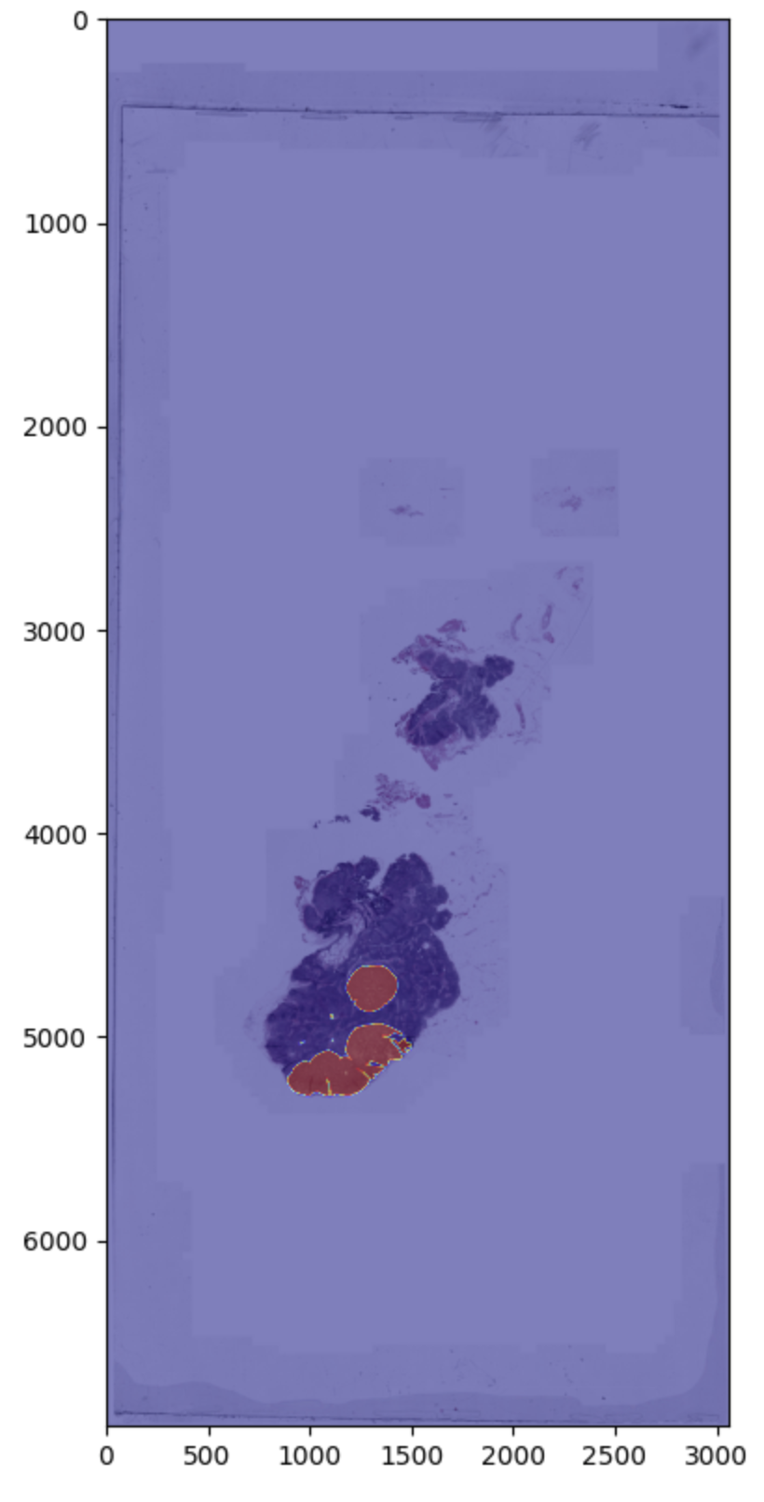
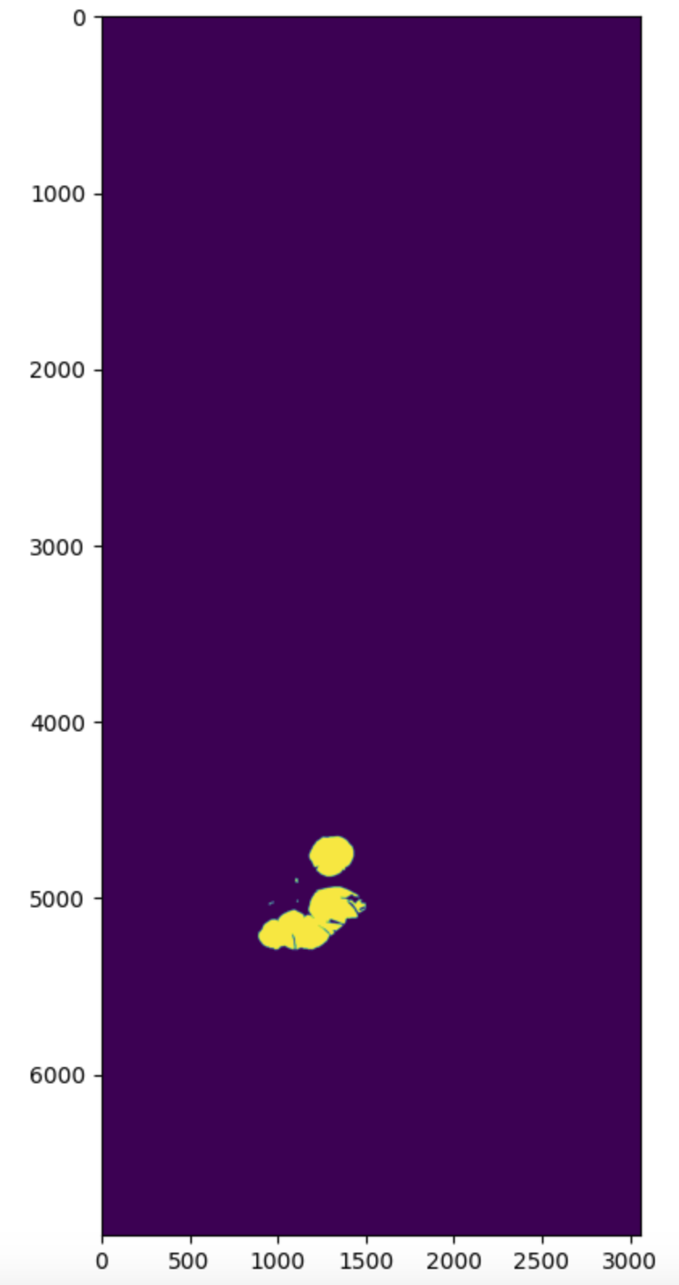
VISUALIZATION
Slide 016 at zoom level 5
Overlay Slide 016
Mask 016 at zoom level 5

Slide 10
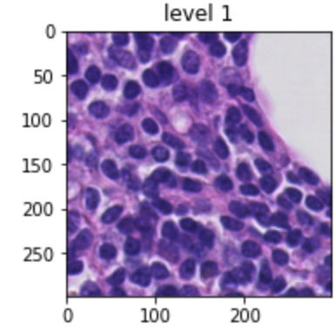
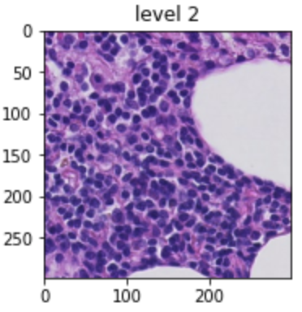
VISUALIZATION

Slide 11
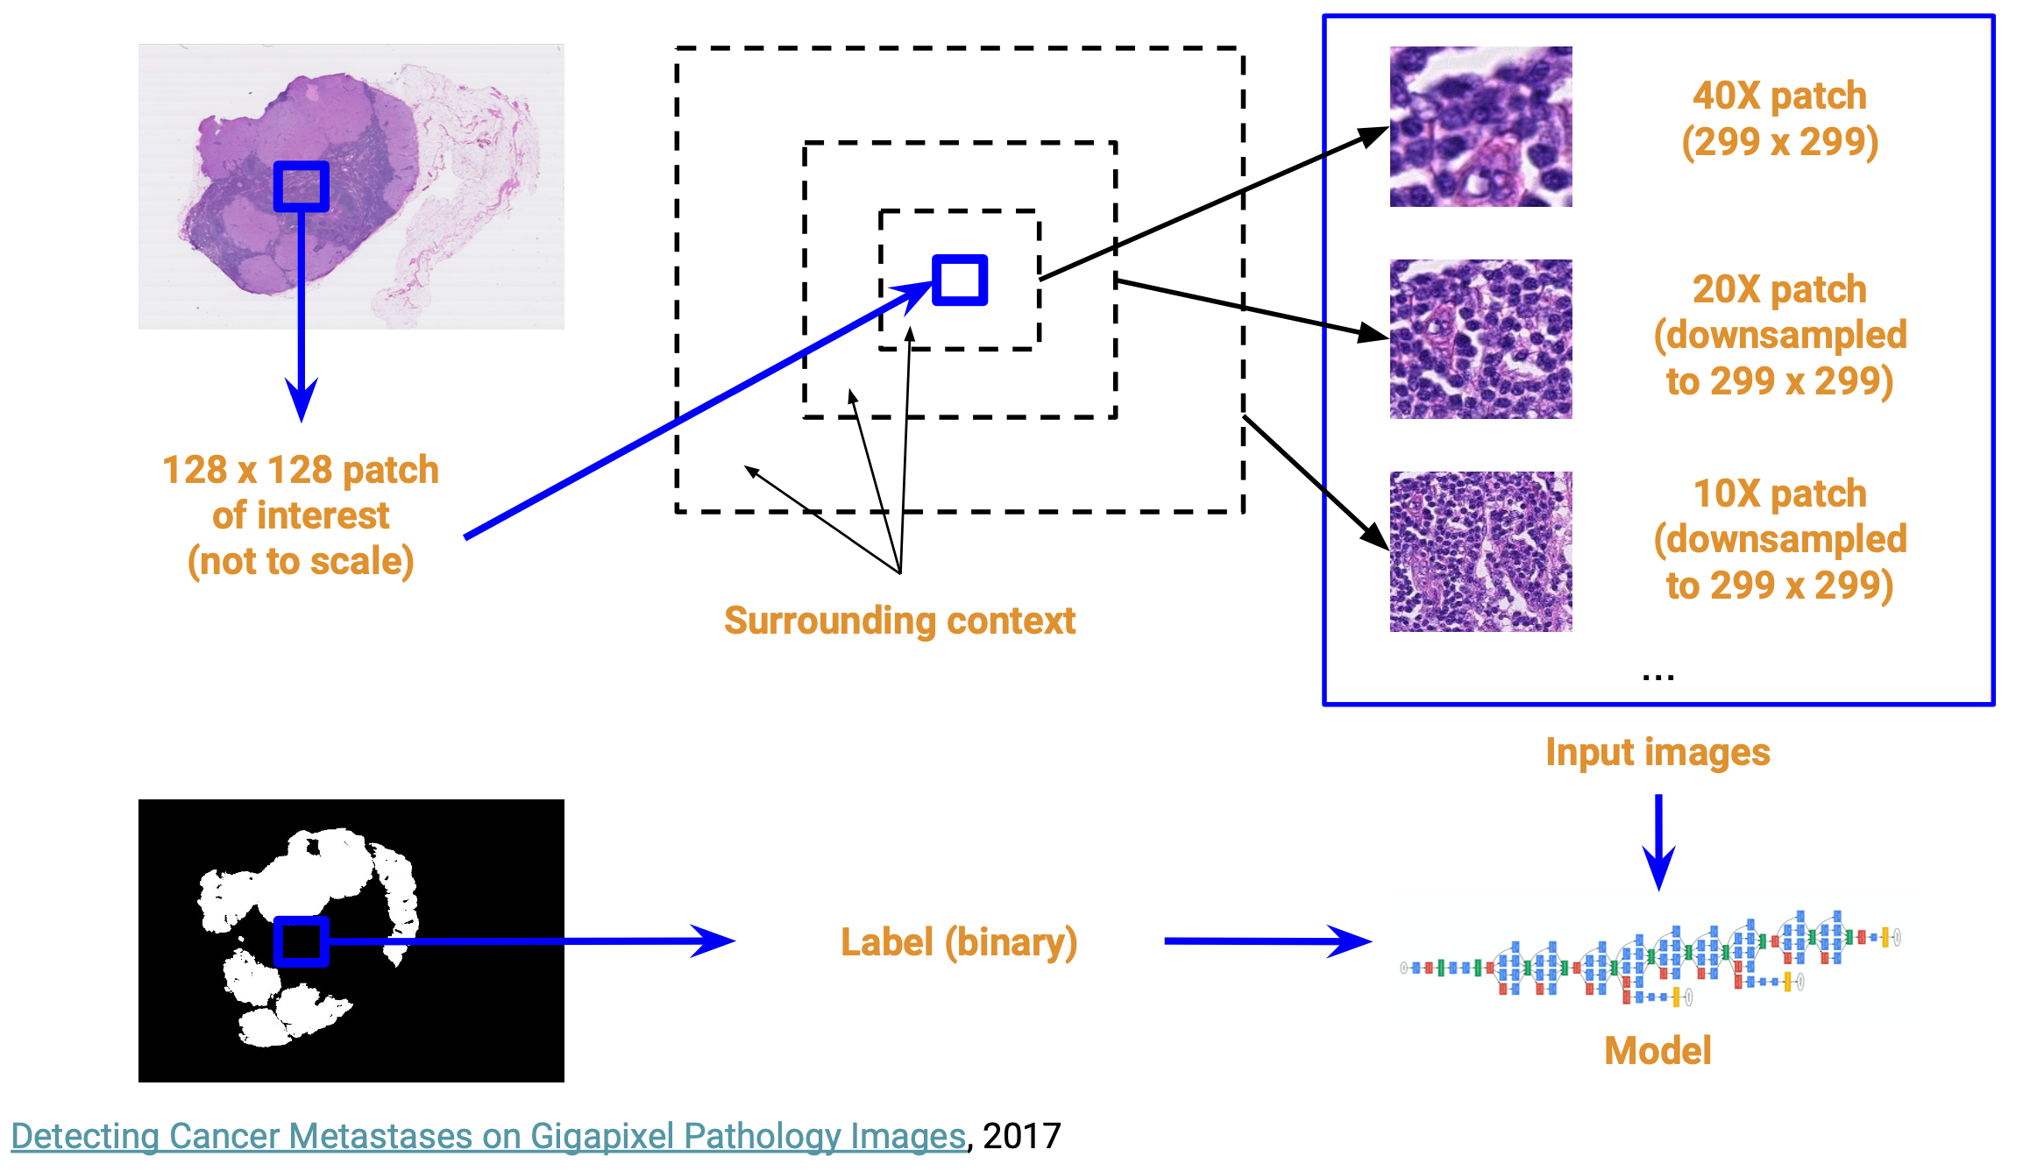
PIPELINE
(32*x-85, 32*y-85)
(16*x-85, 16*y-85)
85
85

Slide 12

PATCH GENERATION
1.
2.
3.
For each slide image, get all the normal pixels and tumor pixels i.e.(x, y) pairs, and retrieve the center of this patch
Repeatedly generate normal patches by locating the central region until n_sample is met
Repeatedly generate tumor patches by locating the central region until n_sample is met

Slide 13
PATCH GENERATION
Training Slide: 016, 075, 101, 110
Validation Slide: 064, 094
Testing Slide: 084, 091
 | Tumor | Normal
Training Data | 1017 | 983
Validation Data | 506 | 494

Slide 14
DATA AUGMENTATION
Horizontal Flip
Vertical Flip
Rotation 90 degree
Shear range 0.2
Brightness: [0.7, 1.3]

Slide 15
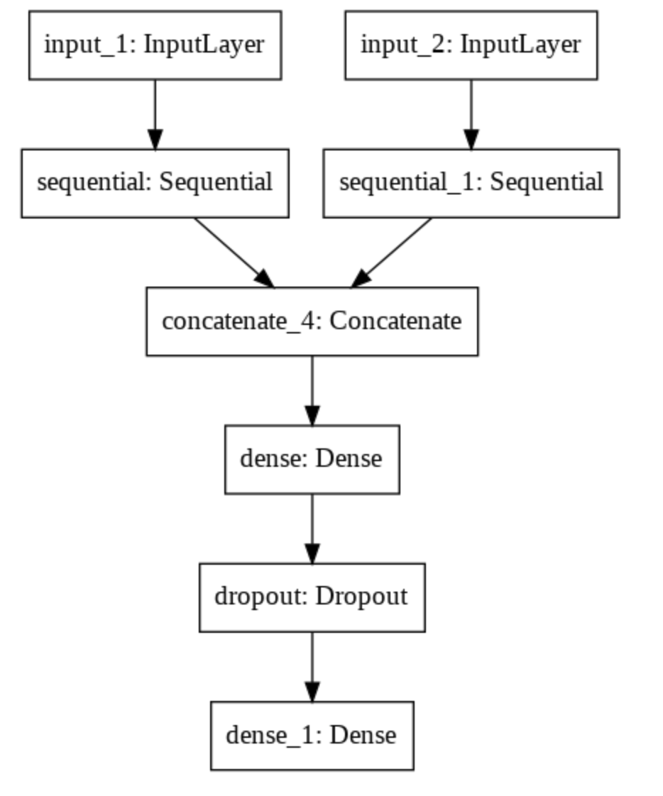
MODEL BUILDING
InceptionV3 as base model
Concatenate model using zoom level 0 and model using zoom level 1
0.2 Dropout is used
A dense layer with sigmoid activation function is built on top

Slide 16
03
RESULT

Slide 17
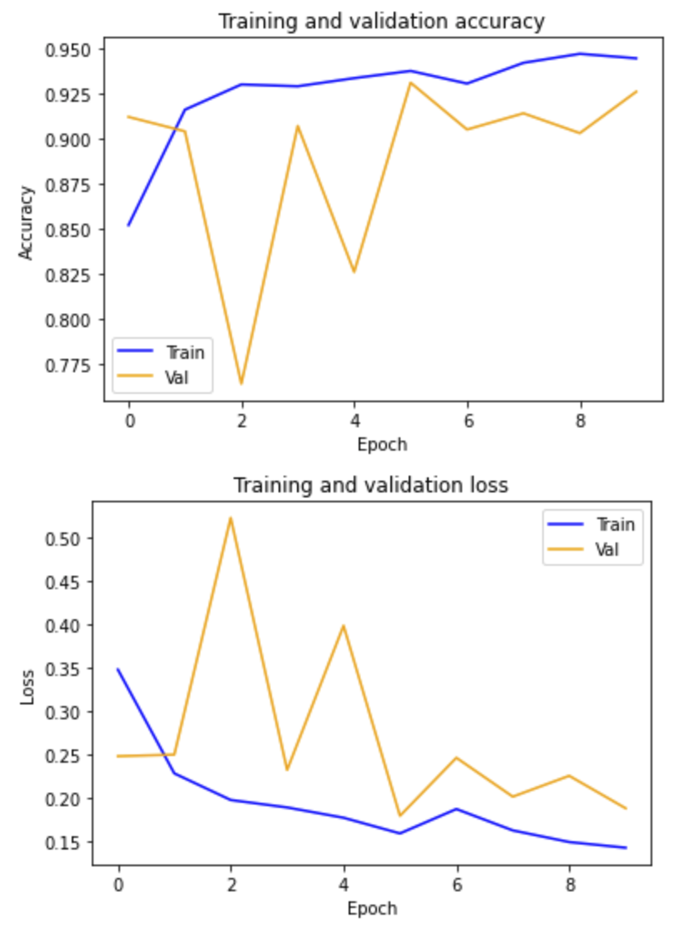
TRAINING MODEL RESULT
 | loss | accuracy
training | 0.1309 | 0.9460
validation | 0.1882 | 0.9260

Slide 18
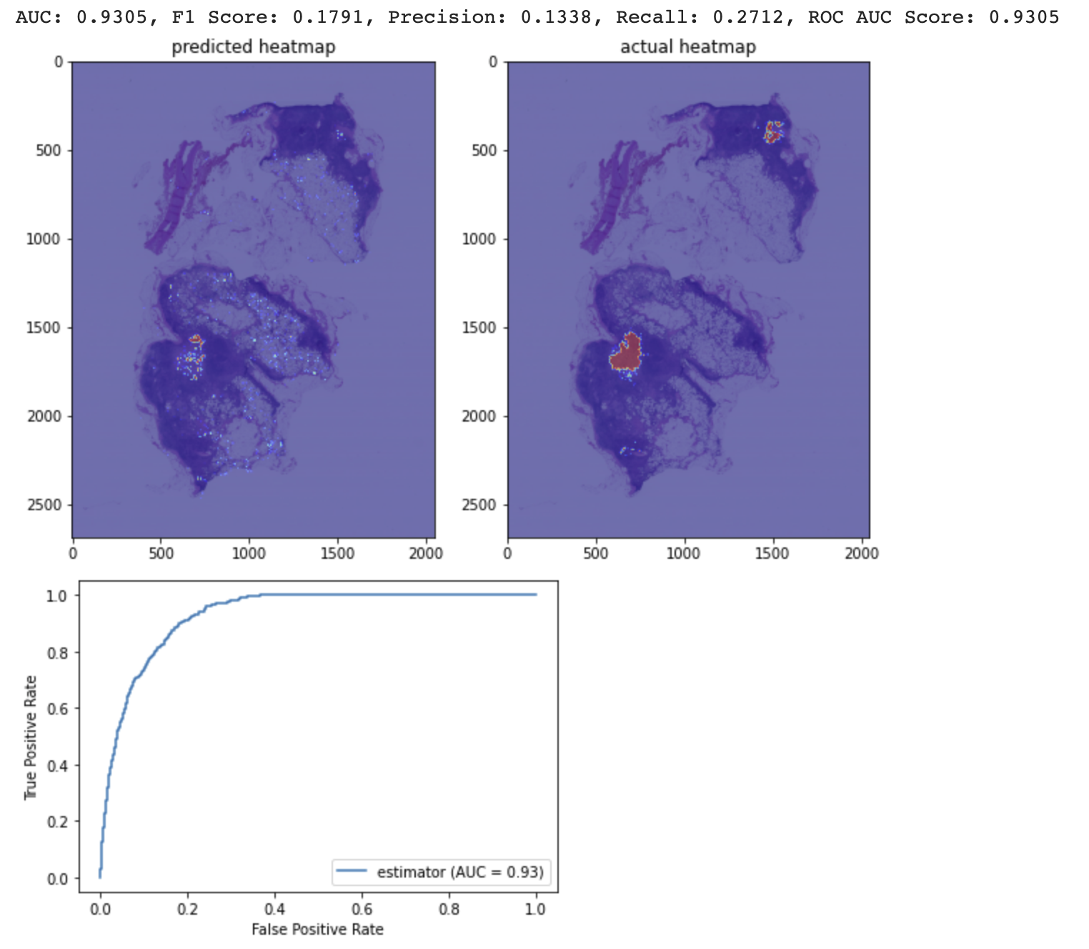
TESTING SLIDE 084
Using 0.7 as threshold while predicting labels

Slide 19
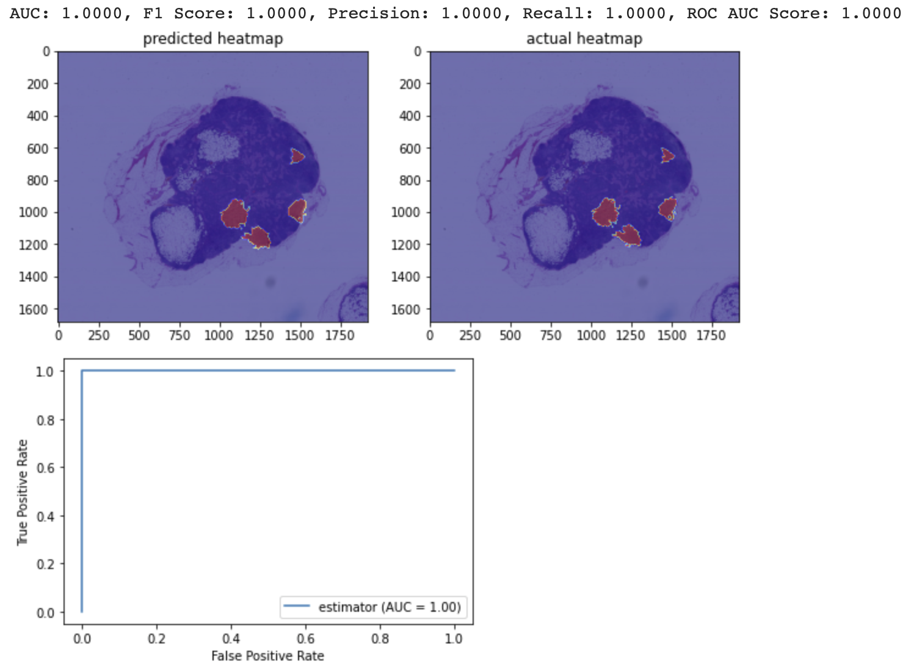
TESTING SLIDE 091
Using 0.7 as threshold while predicting labels

Slide 20
04
CONCLUSION

Slide 21
CONCLUSION
This model performs surprisingly well on slide 091, but not as well on slide 084
Limitation: limited dataset and the model requires excessive amount of RAM, which makes it unrealistic to train and test on local machine
Next step:
Get more data
handle margin while finding pixels in a slide
Better model and threshold tuning

Slide 22
Reference
[1] Detecting Cancer Metastases on Gigapixel Pathology Images

Slide 23
THANKS
For more details: https://github.com/BrianHJLi/Tumor-Tissue-Detection

